Slide 1


Slide 2

IPL DATA ANALYSIS
PRESENTED BY
Syed Abadul Rahaman

Slide 3





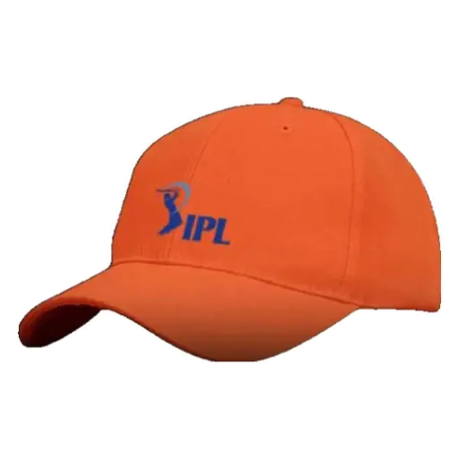






SK Raina
SL Malinga
4548
170
INTRODUCTION
In this Project , we will work on IPL Data Analysis and Visualization Project using Python where we will explore interesting insights from the data of IPL matches like most run by a player, most wicket taken by a player, and much more from IPL season 2008-2017.

Slide 4
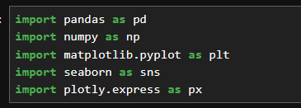
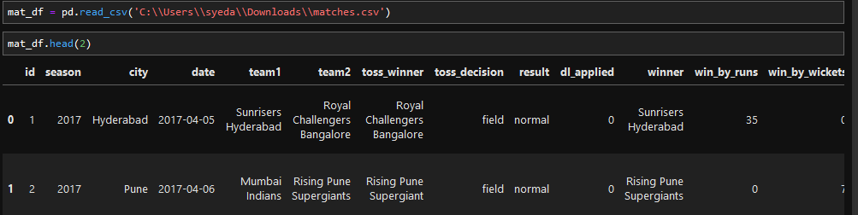
LOADING DATA ……
Libraries and Dataset Used for this project :--
List of Libraries
1. Pandas
2. NumPy
3. Matplotlib
4. Seaborn
5. Statistics
Dataset
1. matches.csv
2. deliveries.csv

Slide 5
DATA UNDERSTANDING
match.csv
This dataset provides matches information in IPL till 2017. It gives information on teams, cities, venues, toss decisions, winners and umpires.
There are a total of 636 rows and 18 columns in the dataframe.
There are 5 columns with a numeric data-type and 13 columns with an object datatype.
2. deliveries.csv
This dataset provides deliveries information in IPL till 2017. It gives ball by ball details of all matches in IPL along with total runs scored by each batsman, wickets taken by each bowler and extras provided in each match.
There are a total of 150460 rows and 21 columns in the dataframe.
There are 13 columns with a numeric data-type and 8 columns with an object datatype.

Slide 6

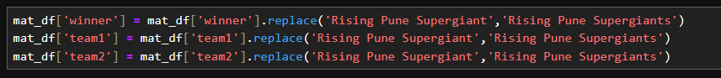
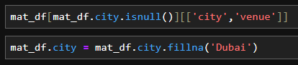
DATA CLEANING
umpire3 column has 100% missing values. hence dropping that column
team1, team2 and winner all 3 columns have rising pune supergiant as well as rising pune supergiants. so we can just keep one of the names
city has missing 7 values

Slide 7
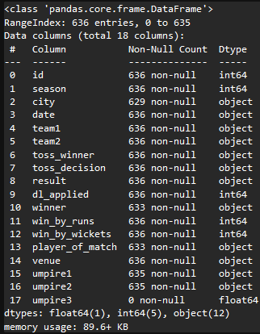
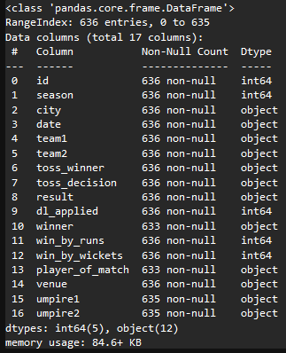
DATA INFORMATION
BEFORE
match.info()
AFTER

Slide 8
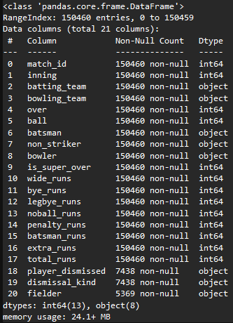
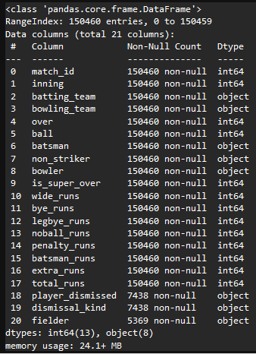
DATA INFORMATION
BEFORE
deliveries.info()
AFTER

Slide 9
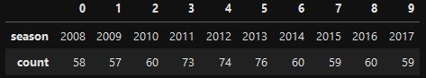
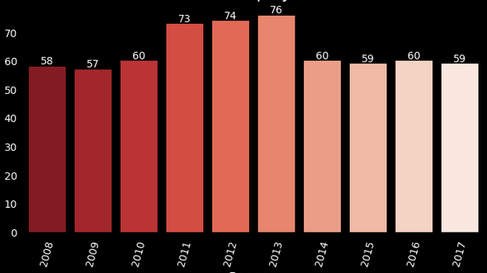
MATCHES PLAYED EACH SEASON
2011-2013 have more matches being played than other seasons
All other seasons have approximately 58-60 matches while 2011-2013 have more than 70 matches

Slide 10
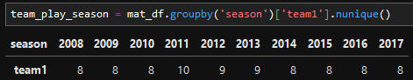
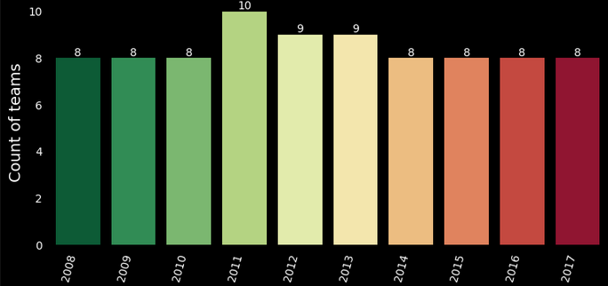
TEAMS PLAYED IN EACH SEASON
10 teams played in 2011 and 9 teams each in 2012 and 2013
This explains why 2011-2013 have seen more matches being played than other seasons

Slide 11
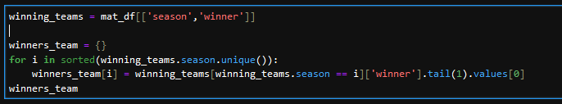
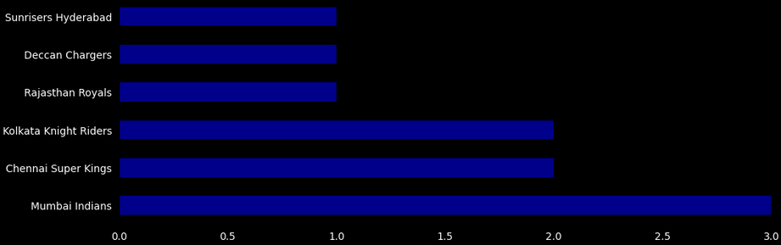
WINNER ACROSS 10 SEASON 2008-2017
MI has won 3 times.
CSK and KKR have both won 2 times each.
Actually Hyderabad team has also won 2 matches under 2 franchise name - Deccan Chargers and Sunrisers Hyderabad

Slide 12
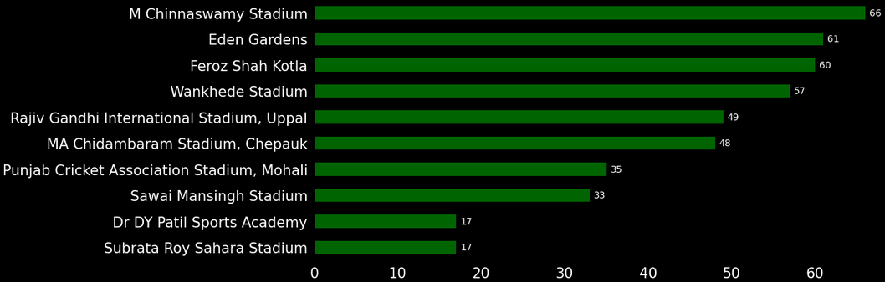
Top Venue for IPL Matches
M Chinnaswamy Stadium in Bengaluru has hosted the highest number of matches so far in IPL followed by Eden Gardens in Kolkata

Slide 13
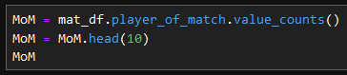
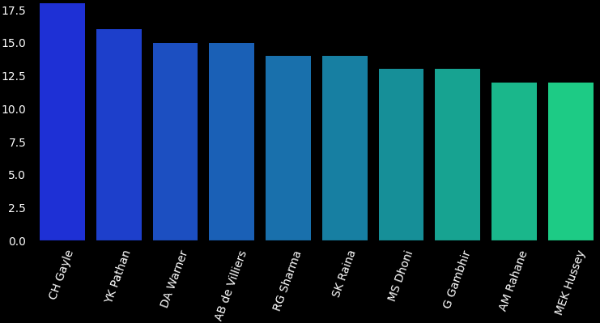
PLAYERS WITH MOST MoM AWARDS
Chris Gayle has so far won the most number of MoM awards followed by YK Pathan.
Players like MS Dhoni and Gautam Gambhir, who have also been team captains, appear on the list, indicating that leadership and experience can also correlate with match-winning performances.

Slide 14
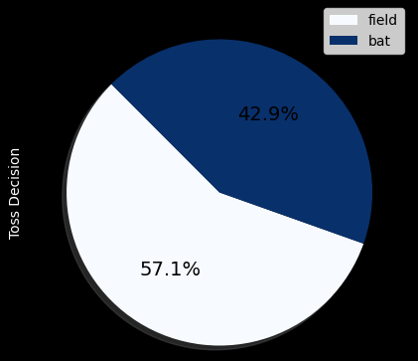
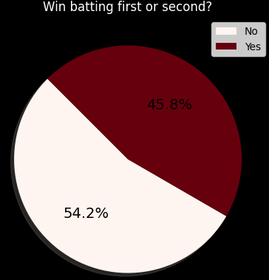
TOSS DECISION BY CAPTAIN
Close to 60% times teams who have won tosses have decided to chase down
Teams batting second have won 54% times.

Slide 15
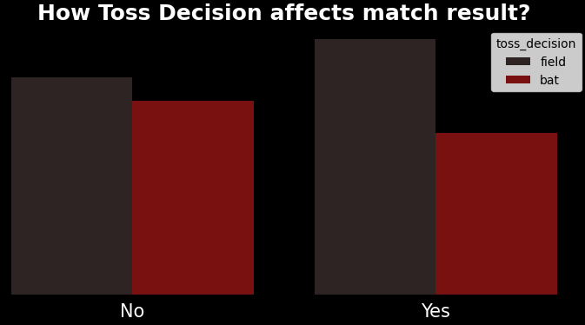
TOSS CHOICES AND MATCH SUCCESS
Teams winning tosses and electing to field first have won most number of times.

Slide 16
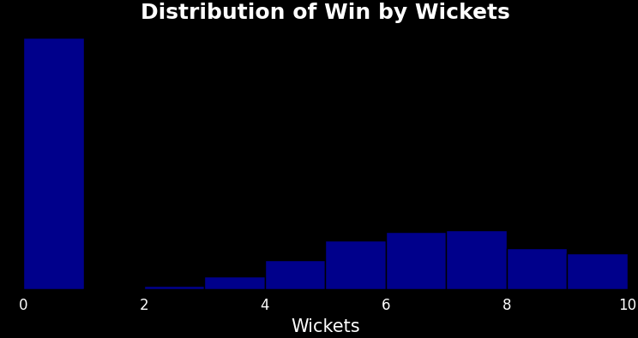
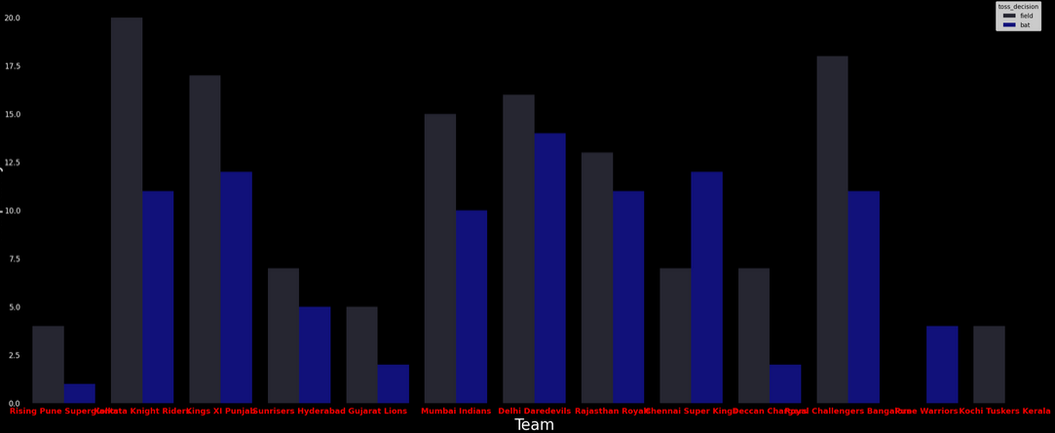
TEAMS WINNING BY BIG WICKET MARGIN
The distribution is right-skewed, which indicates that most matches are won by a relatively small number of wickets.
KKR, Kings XI Punjab, Delhi Daredevils and RCB have won by good wicket margins over the years and they have all decided to field first after winning toss

Slide 17
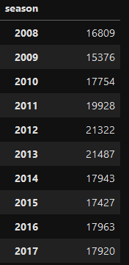

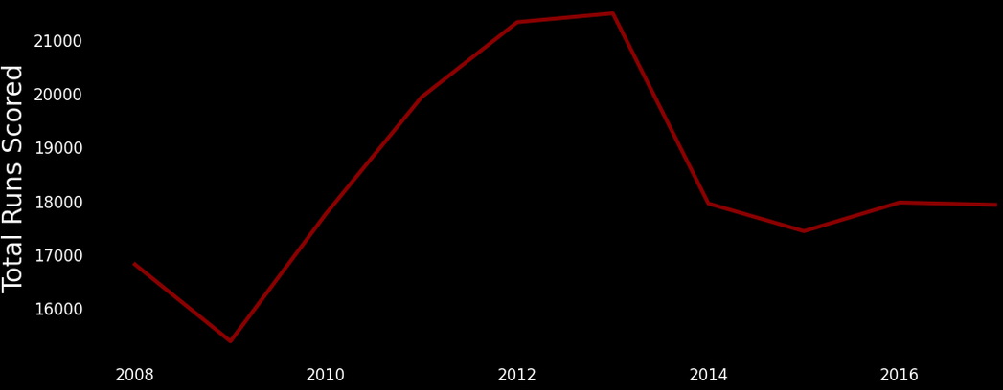
RUNS OVER THE YEARS
There was a decline in total runs from 2008 to 2009. But there after there was a substantial increase in runs in every season until 2013, but from next season there was a slump in the total runs. But the number of matches are not equal in all seasons. We should check the average runs per match in each season:

Slide 18
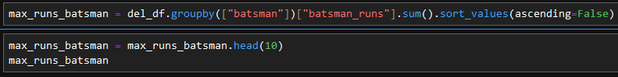
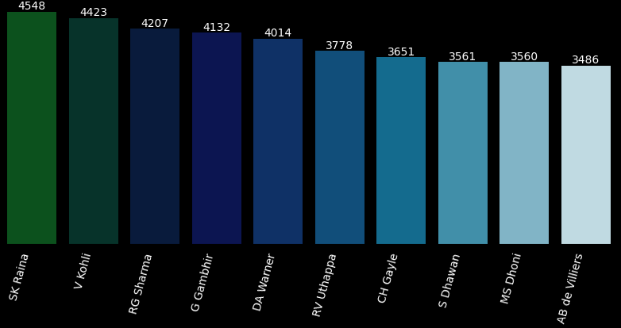
BATSMAN WITH THE MOST RUNS
Suresh Raina is the highest run getter in IPL followed by Virat Kholi

Slide 19
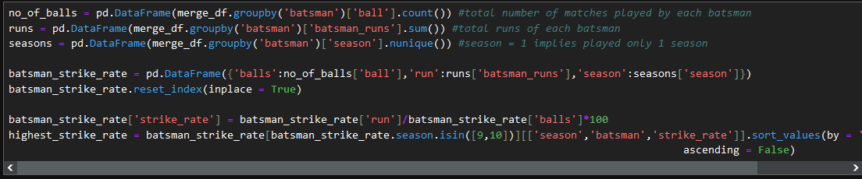
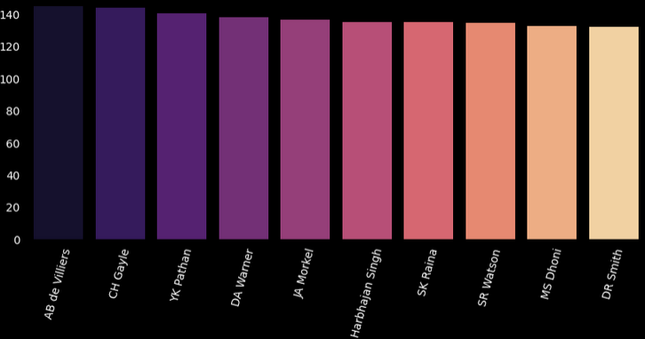
HIGHEST STRIKE RATES BY BATTER
AB de Villiers, Gayle have the highest strike rates in IPL. They are the big hitters and can win any match on their day
One surprise here is that Harbhajan Singh who is a bowler has a strike rate of 130+ and comes before Sk Raina in raking

Slide 20
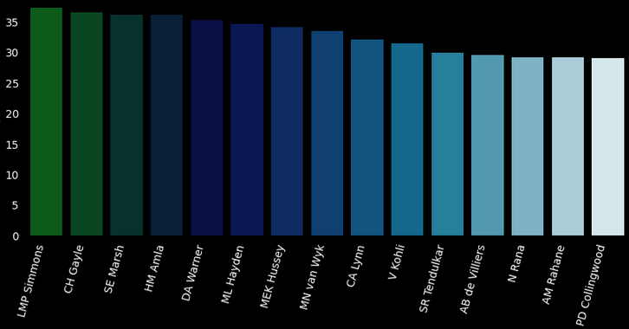
HIGHEST BATTING AVERAGES IN IPL
LMP Simmons has the highest average followed by CH Gayle and SE Marsh
Rahane, Warner and Hayden might not be in the top 10 run getters but have maintained a good average over the years.

Slide 21
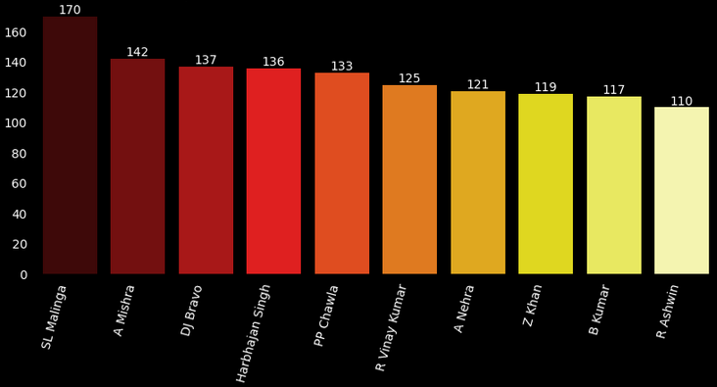
MOST WICKETS TAKERS
Malinga has taken the most number of wickets in IPL followed by Amit Mishra and Bravo

Slide 22
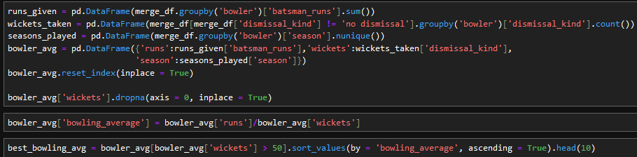
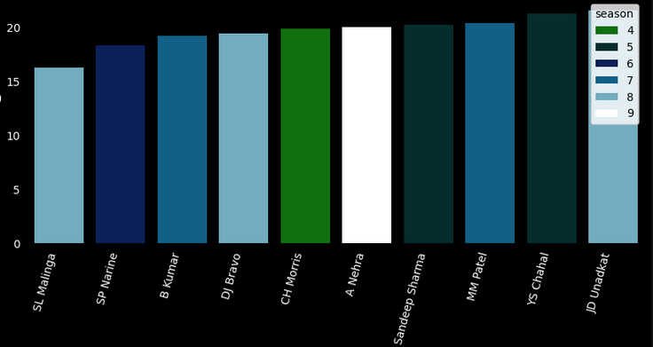
BEST BOWLING AVERAGES
Malinga has taken the most wickets at the best avg of 16.27.
Malinga, Bravo, Nehra have played 8 and above seasons and hence have taken more wickets and improved average

Slide 23
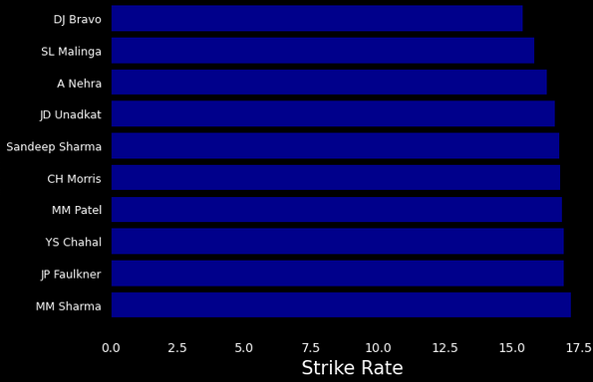
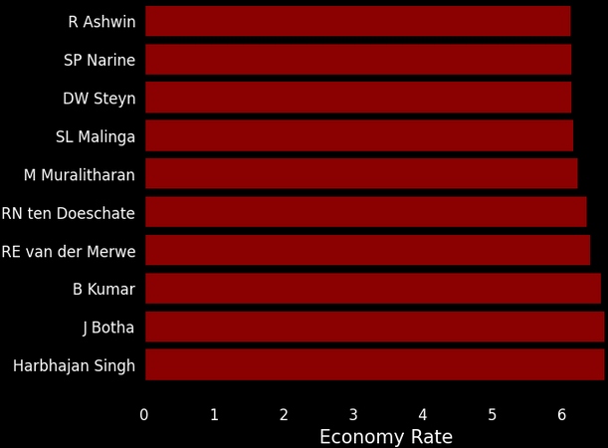
BOWLER
STRIKE RATE
ECONOMY RATE
SL Malinga appears on both lists, indicating his effectiveness both in taking wickets frequently and in controlling the run rate. This makes him an exceptionally valuable bowler.
Bowlers like DJ Bravo and A Nehra are more focused on taking wickets frequently (strike rate)
Bowlers like R Ashwin and SP Narine are more focused on restricting runs (economy rate)

Slide 24
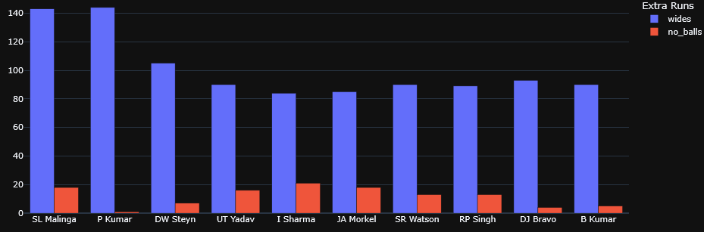
EXTRAS RUN GIVEN BY BOWLER
Malinga has given away most extras even he has most wicket takers and also good economy and strike rate
Top 10 in this list are all pacers

Slide 25
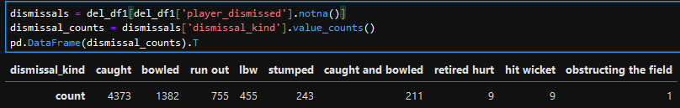
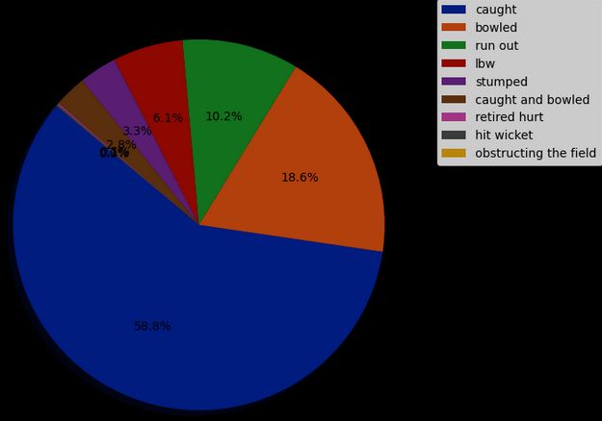
DISTRIBUTION OF DISMISSAL TYPES
The high percentages of 'caught,' 'bowled,' and 'lbw' dismissals suggest that bowlers are either inducing batsmen to make errors or are bowling with precision
The presence of run-out dismissals highlights the importance of good fielding and careful running between the wickets.
The distribution shows that while batsmen are often aggressive (leading to being caught)

Slide 26
CONCLUSION
Most teams decide to chase down totals after winning toss except for CSK which goes well with the fact that the have won most games (by good margin) by defending
54% times teams who have chased irrespective of winning or losing toss have won matches. But teams winning tosses and electing to field first have won most number of times. It has been uniform across all venues. Particularly KKR, KIX Punjab, DD and RCB have won by big wicket margin
MoM awards have mostly been received by batsmen implying t20 is a more batsmen-oriented game.
Suresh Raina has been most consistent batsmen among top run getters while AB has had the highest strike rate among all players who have played 10 or more seasons
Gayle has had the best average of 36.4 among all batsmen with more than 9 seasons. He has been sensational with most number of Man of the Match awards
Rahane, Watson are not in top 10 run getters but have maintained a good average across the seasons
Malinga has been the most impressive bowler in IPL with more than 170 wickets at an average of 16.27, economy of 6.16 and strike rate of 15.84
Spinners generally do not give away many extra runs and all bowlers in top 10 of that list are pacers.

Slide 27


